Slide 1

Pairs Trade KO and PEP
Jason Tian

Slide 2
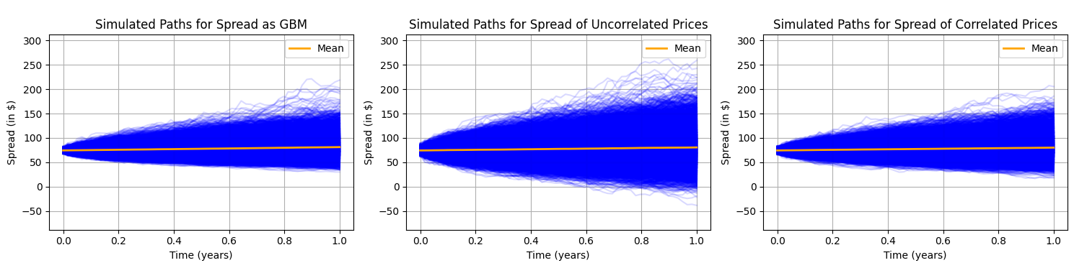
Simulating Price Paths
First, assume PEP and KO prices follow uncorrelated/correlated GBM processes
We can see the correlated spread is more compressed than the uncorrelated version
However, for pairs trading we should try using an OU mean-reverting process

Slide 3
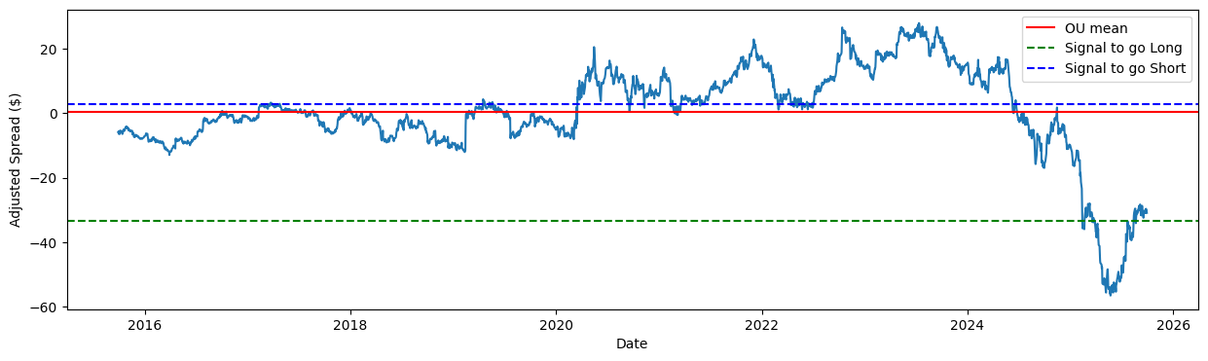
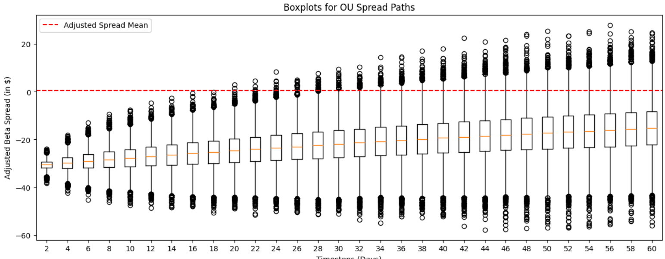
Pairs Trade with OU process
Assume one beta value/hedge ratio
  2.590 KO shares per PEP share
Adjusted spread has very low mean reversion
  Appears to nosedive from 2025 onwards
Long spread if >= -$33.45, Short if <= $2.88
  Current spread value far below mean
Backtest with simulated paths, pairs trade for 1 week
  5% loss is -$3421.01,
  Expected trade value is $1289.24
  95% profit is $6041.22

Slide 4
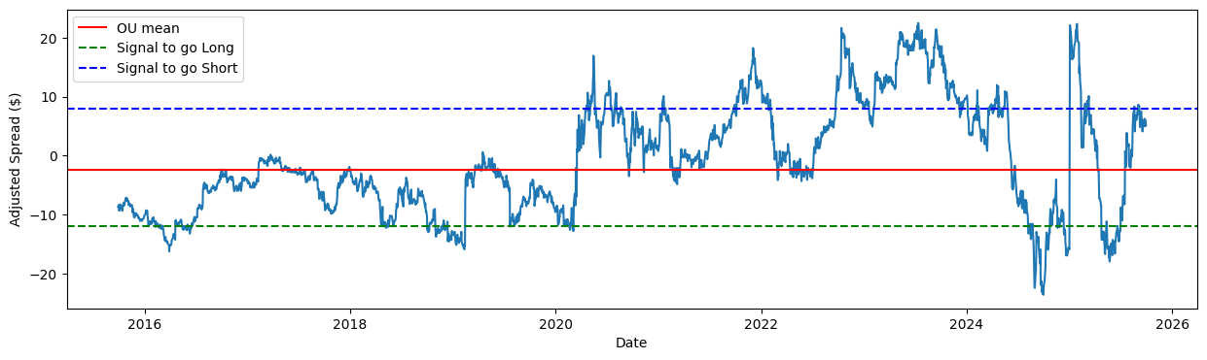
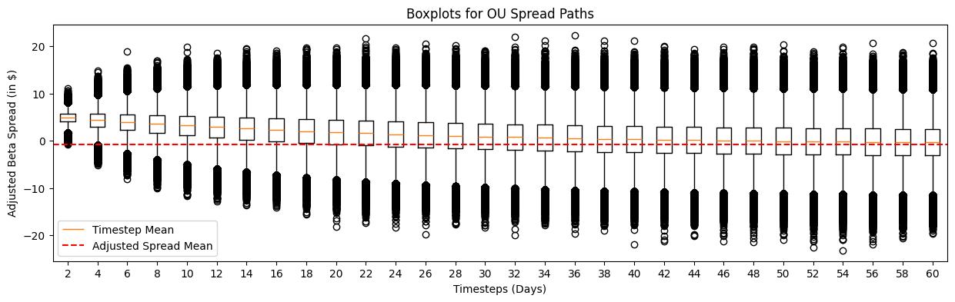
Accounting for Structural Break
Assume a structural break at end of 2024
  Beta before 2024 is 2.685
  Beta after 2025 is 2.045
Adjusted spread now strongly bounded, reverts quickly
  Pairs trading with this spread assumes occasionally changing beta for structural break/changes
Long spread if >= -$11.97, Short if <= $8.02
  Covers most peaks
  Won’t suffer from small peaks/early reversion
1-week pairs trade is less risky on this adjusted spread
  5% loss is -$2094.11,
  Expected trade value is $811.92
  95% profit is $3718.04

